Slide 1
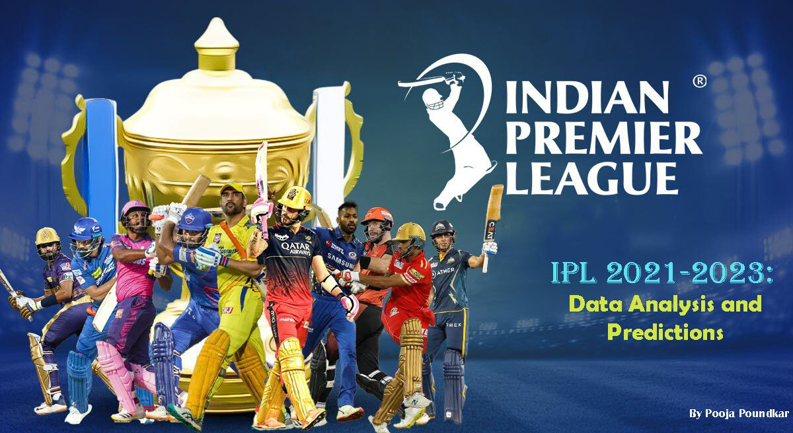


Slide 2
FIRST EDITION
IPL OVERVIEW
2008
FORMAT
The Indian Premier League (IPL) premier Twenty20 cricket league in India. Renowned for its high-energy matches and star-studded teams representing cities, the IPL has become a global cricketing phenomenon. With innovative formats and top international players, it blends entertainment and competition, captivating a massive fan base. The IPL has redefined modern cricket, elevating it beyond a sport to a cultural spectacle.
Twenty20
NUMBER OF TEAMS
TEN ( 10 )
ADMINISTRATOR
BCCI
( Board of Control for Cricket in India )
HEADQUARTERS
Cricket Centre, Churchgate,
Mumbai, Maharashtra

Slide 3

TEAM PLAYING
CHENNAI SUPER KINGS
MUMBAI INDIANS
DELHI CAPITALS
PUNJAB KINGS
GUJRAT TITANS
RAJASTHAN ROYALS
ROYAL CHALLENGERS BANGALORE
KOLKATA KNIGHT RIDERS
LUCKNOW SUPER GIANTS
SUNRISERS HYDERABAD

Slide 4
PROBLEM STATEMENT
"Sports Basics" is a sports blog company that entered space recently. They wanted to get more traffic to their website by releasing a special edition magazine on IPL 2024.
This magazine aims to provide interesting insights and facts for fans, analysts and teams based on the last 3 years' data.
The chief editor Tony Sharma oversees this publication, and he believes in data analytics. He reached out to Peter Pandey, a journalist in his team who is a data savvy cricket enthusiast

Slide 5
OBJECTIVES
Top 10 batsmen based on past 3 years total runs scored.
Top 10 batsmen based on past 3 years batting average. (min 60 balls faced in each season)
Top 10 batsmen based on past 3 years strike rate (min 60 balls faced in each season)
Top 10 bowlers based on past 3 years total wickets taken.
Top 10 bowlers based on past 3 years bowling average. (min 60 balls bowled in each season)
Top 10 bowlers based on past 3 years economy rate. (min 60 balls bowled in each season)
Top 5 batsmen based on past 3 years boundary % (fours and sixes).
Top 5 bowlers based on past 3 years dot ball %.
Top 4 teams based on past 3 years winning %.
Top 2 teams with the highest number of wins achieved by chasing targets over the past 3 years.

Slide 6
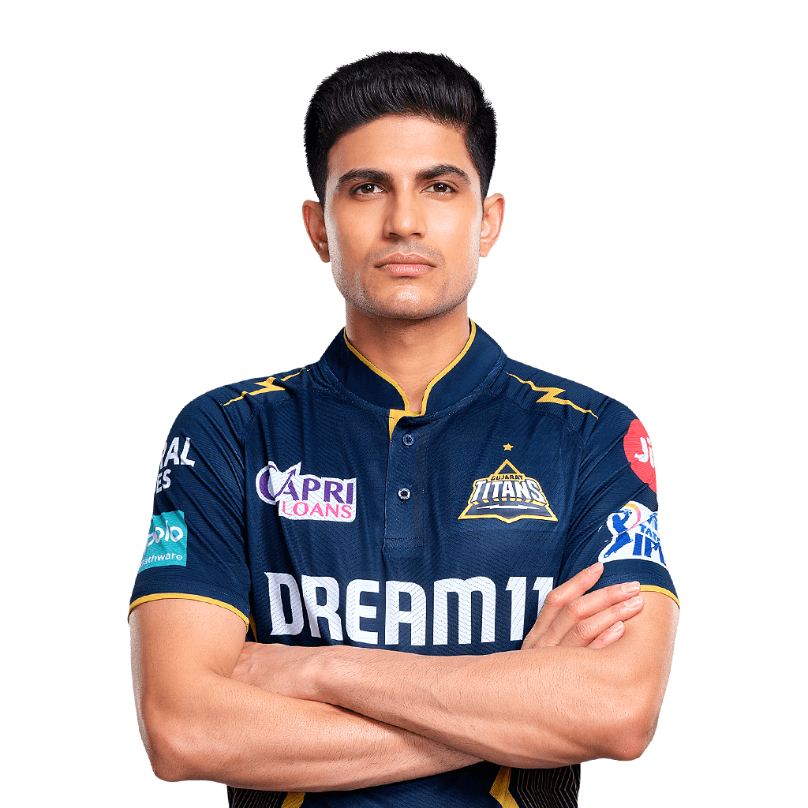
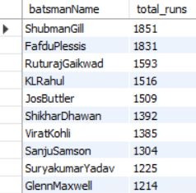


MYSQL QUERIES
1. Top 10 batsmen based on past 3 years total runs scored
Shubman Gill has performed excellently over the years and has scored the highest number of runs overall.
Faf du Plessis, Ruturaj Gaikwad, K L Rahul, and Jos Buttler have performed excellently over the past three years.

Slide 7
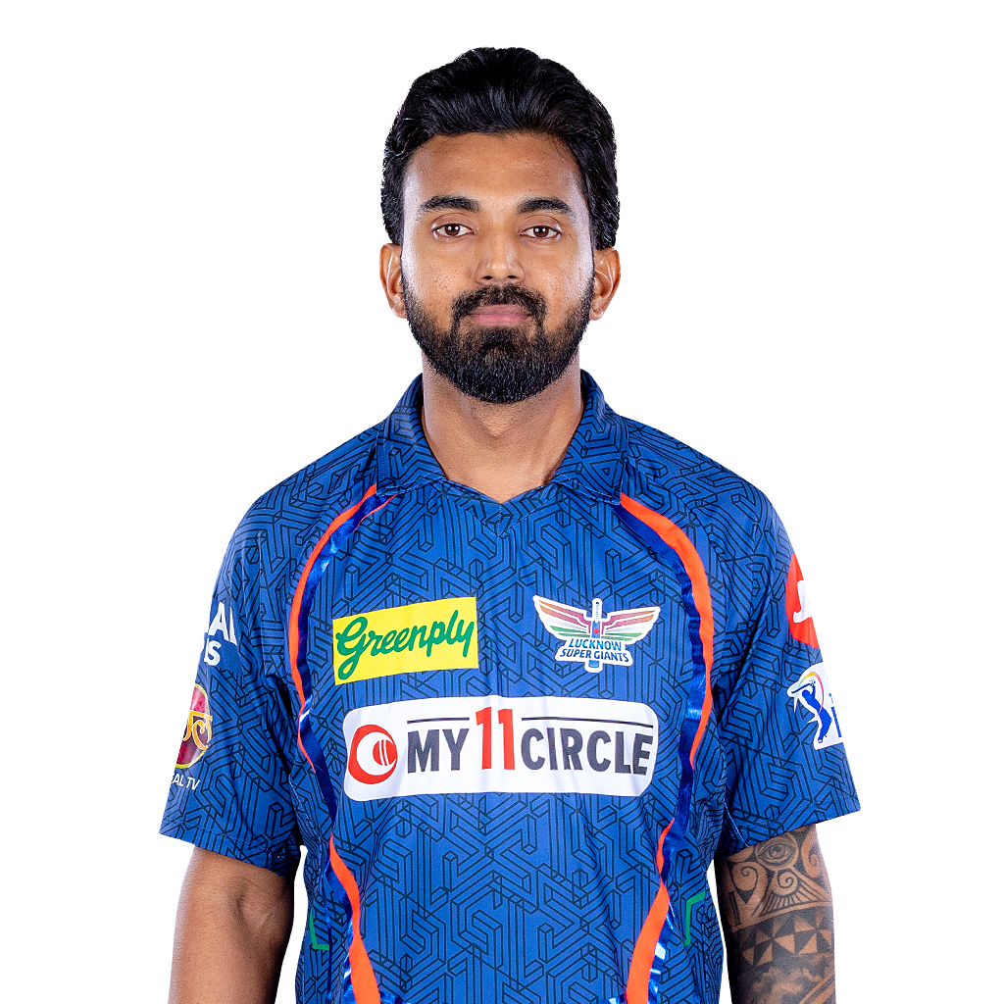
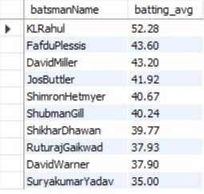
2. Top 10 batsmen based on past 3 years batting average.
(min 60 balls faced in each season)
K L Rahul leads the table with the highest batting average.
Faf du Plessis, David Miller, and Jos Buttler have batting averages of 40+, making them among the best batsmen in terms of averages.

Slide 8

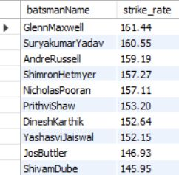
3. Top 10 batsmen based on past 3 years strike rate.
(min 60 balls faced in each season)
Glenn Maxwell and Suryakumar Yadav lead the table with a strike rate exceeding 160.
Following closely behind are Andre Russell, Shimron Hetmyer and Nicholas Pooran, demonstrating similarly impressive strike rates.

Slide 9
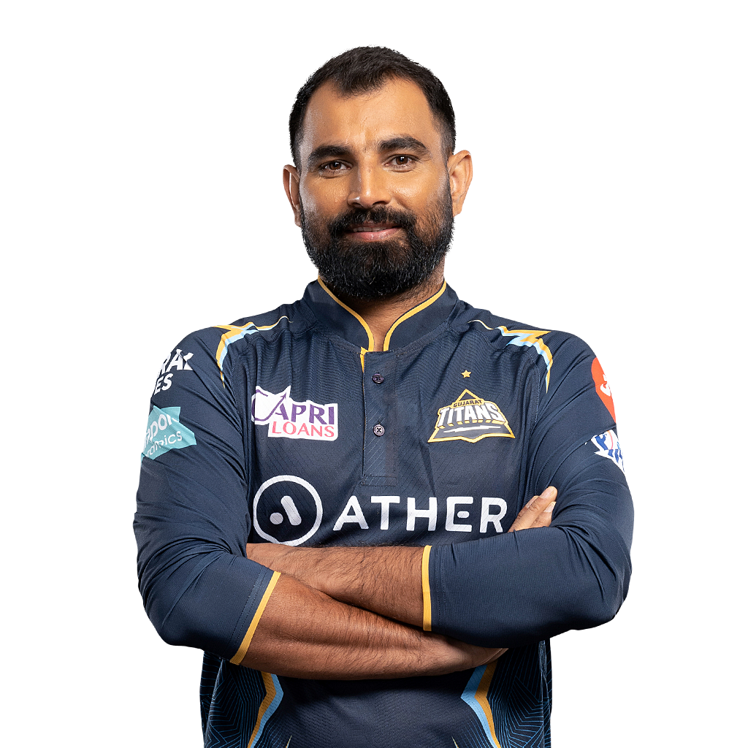
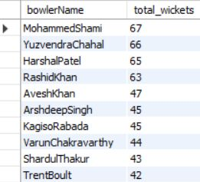
4. Top 10 bowlers based on past 3 years total wickets taken.
Mohammad Shami has taken 67 wickets, leading the table.
Yuzvendra Chahal, Harshal Patel, and Rashid Khan are among the top 10 wicket-takers.

Slide 10
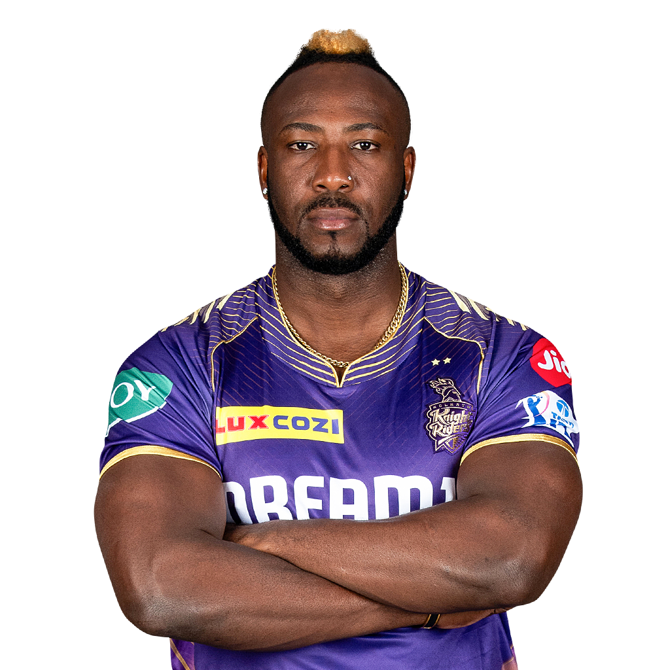
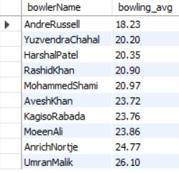
5. Top 10 bowlers based on past 3 years bowling average.
(min 60 balls bowled in each season)
Andre Russell boasts an impressive bowling average of 18.23.
Y. Chahal, Harshal Patel, and Rashid Khan closely follow with bowling averages ranging from 20.20 to 20.90.

Slide 11
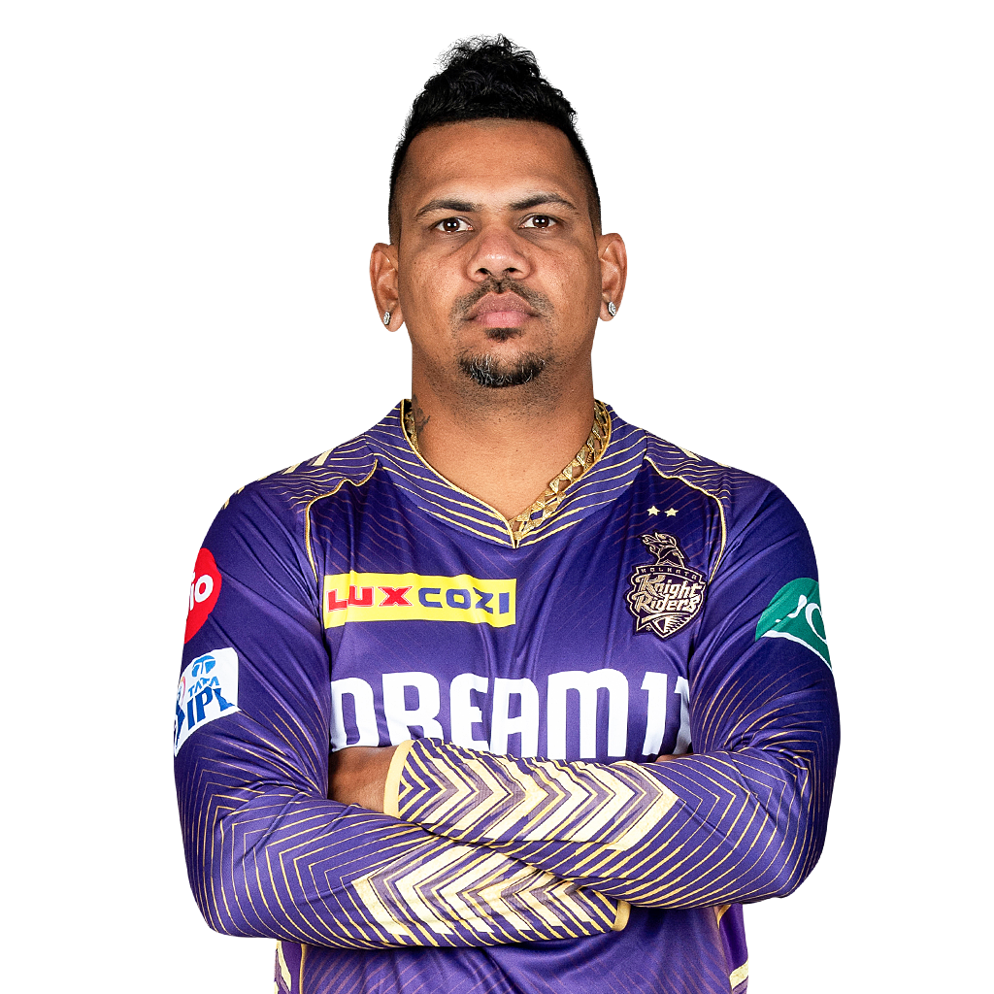
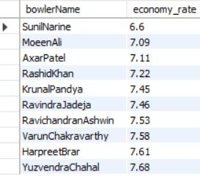
6. Top 10 bowlers based on past 3 years economy rate.
(min 60 balls bowled in each season)
Sunil Narine maintains a commendable economy rate of 6.6.
Moeen Ali, Axar Patel and Rashid Khan closely trail with economy rates between 7.09 and 7.22.

Slide 12
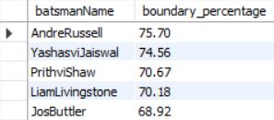
7. Top 5 batsmen based on past 3 years boundary % (fours and sixes).
Andre Russell leads as the top batsman in boundary percentage.
Yashaswi Jaiswal, Prithvi Shaw, Liam Livingstone and Jos Buttler are close contenders.

Slide 13
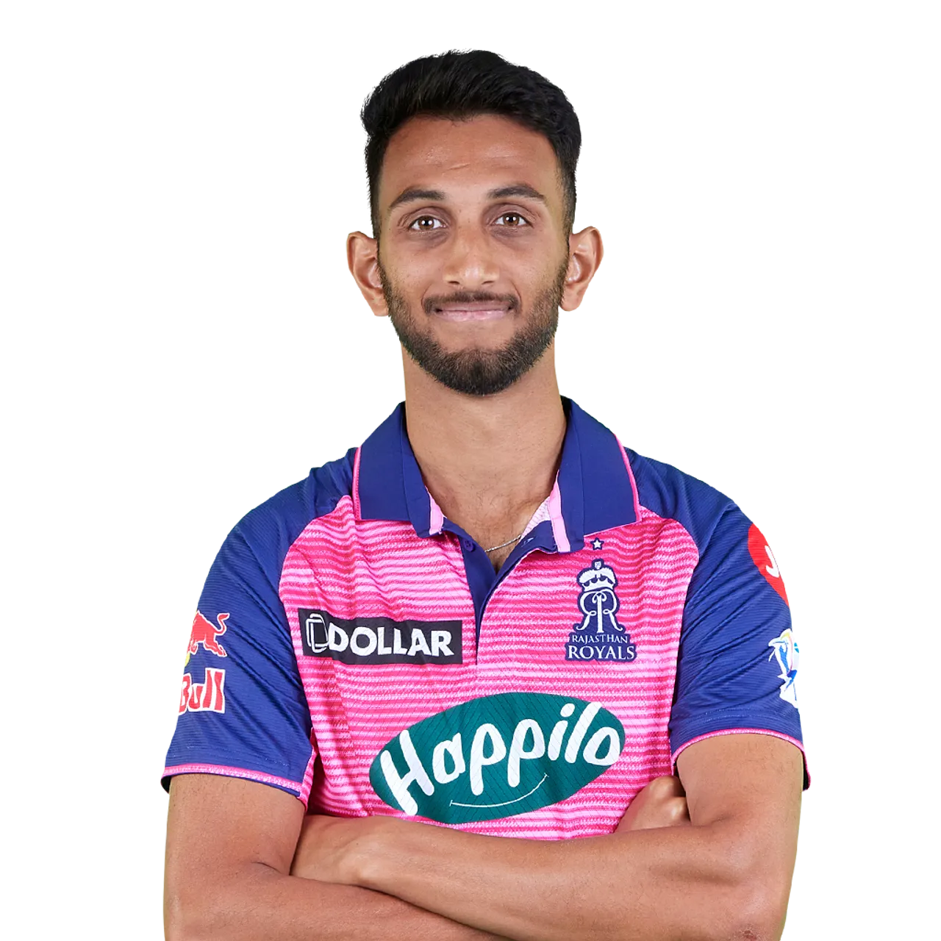
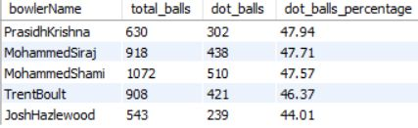
8. Top 5 bowlers based on past 3 years dot ball %.
Prasidh Krishna emerges as the leading bowler in dot ball % among the top five.
Mohammad Siraj, Mohammed Shami, Trent Boult and Josh Hazlewood also showcase strong performances with a high rate of dot balls.

Slide 14



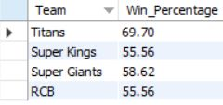

9. Top 4 teams based on past 3 years winning %
Titans dominate with the highest winning percentage.
Super Giants follow closely behind, while both Super Kings and RCB maintain strong records, solidifying their competitive standing in recent seasons.

Slide 15

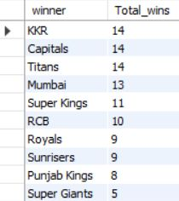
10. Top 2 teams with the highest number of wins achieved by chasing targets over the past 3 years.
KKR, Delhi, and Titans jointly hold the top spot with 14 wins each achieved by chasing targets.
Mumbai closely trails with 13 wins in the same period.

Slide 16
DASHBOARD

Slide 17
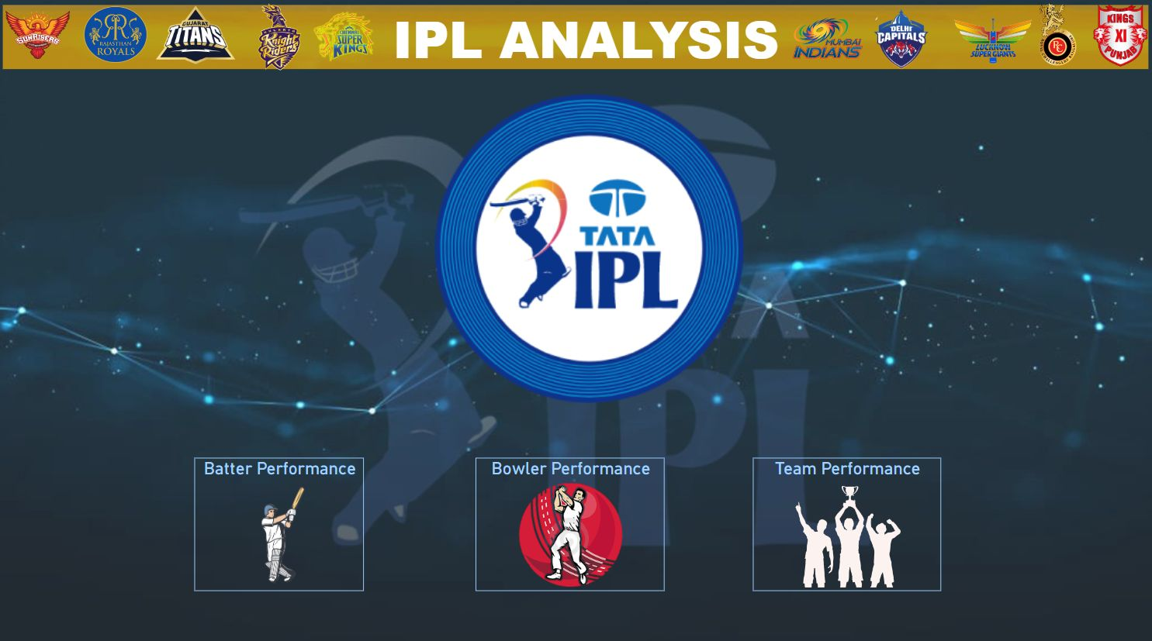

Slide 18
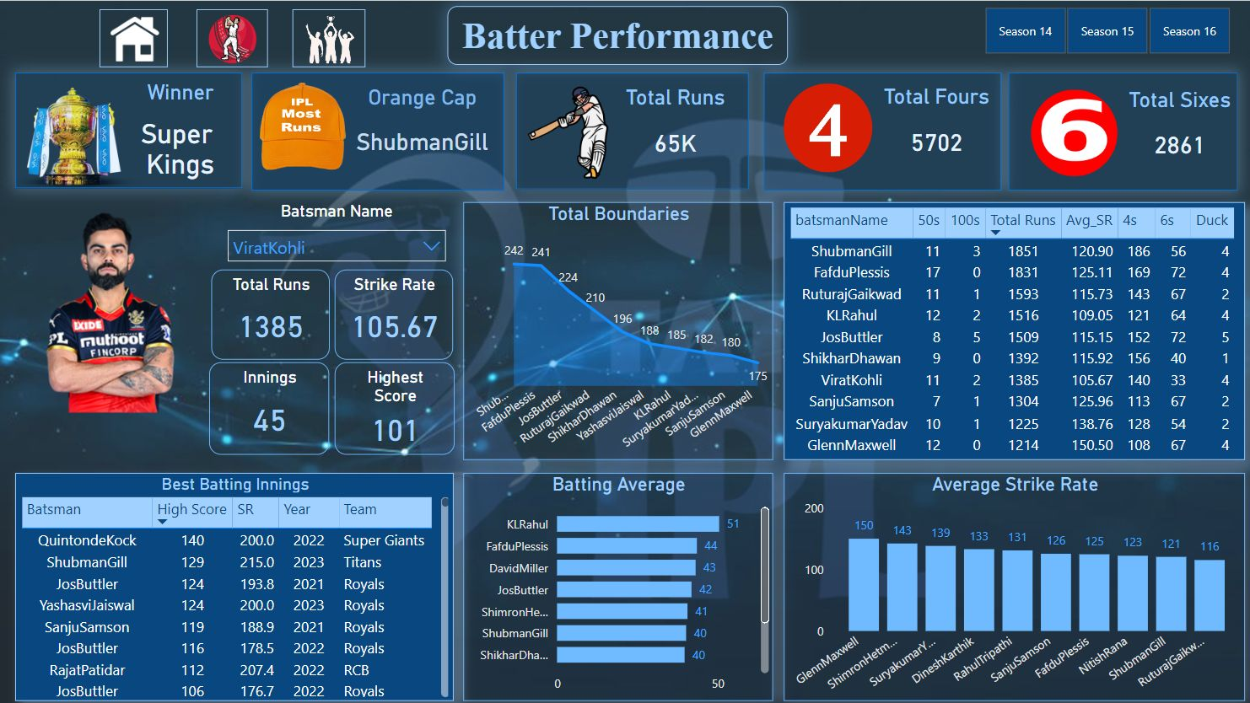

Slide 19
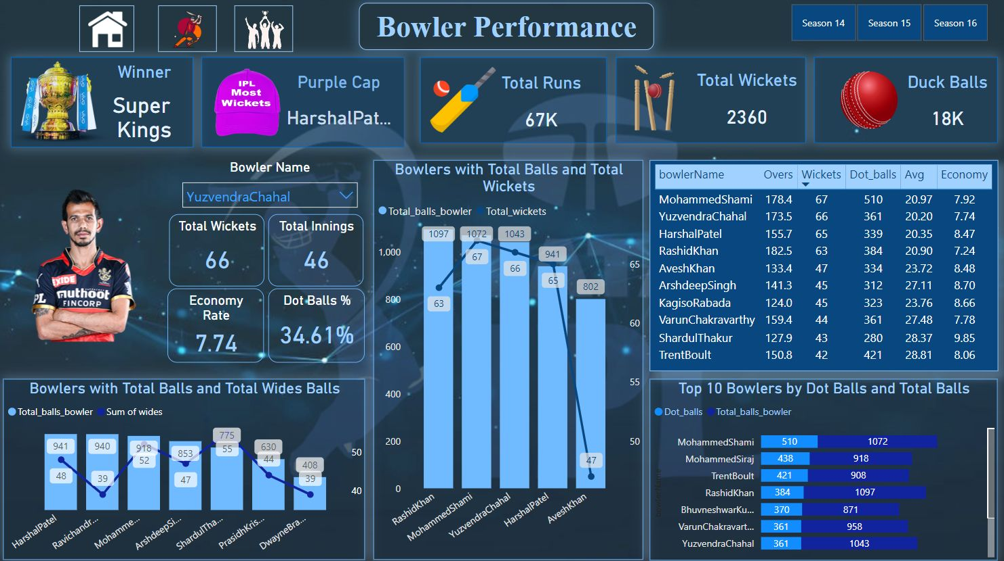

Slide 20
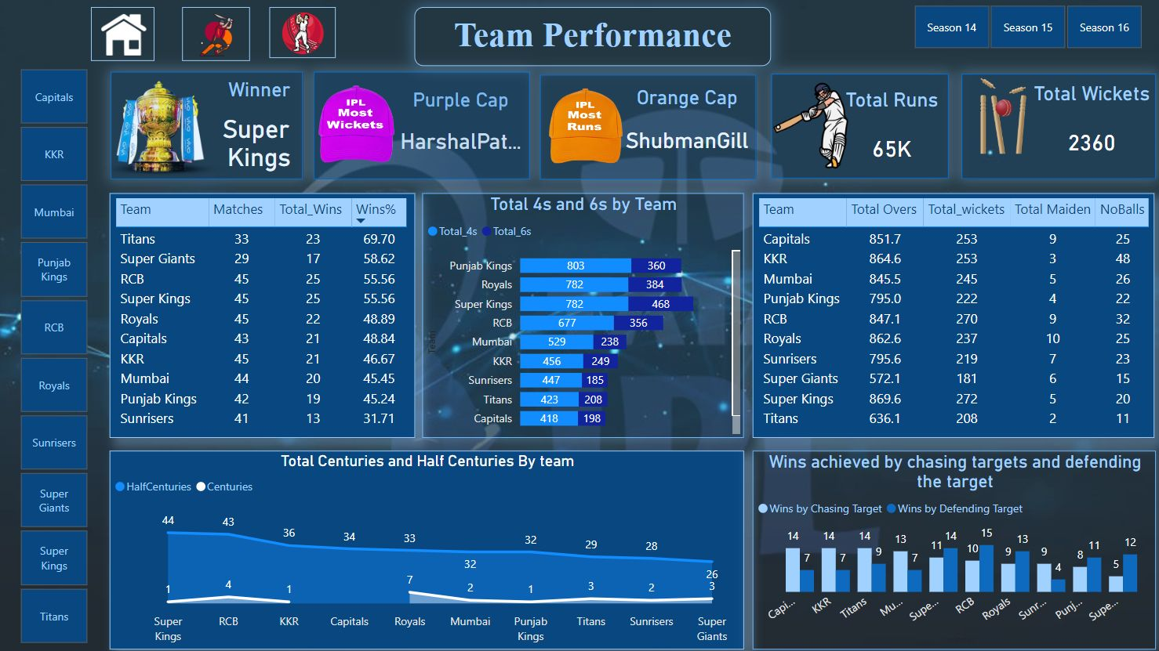

Slide 21
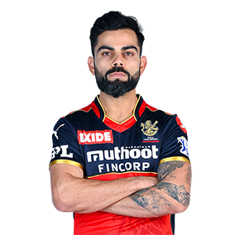
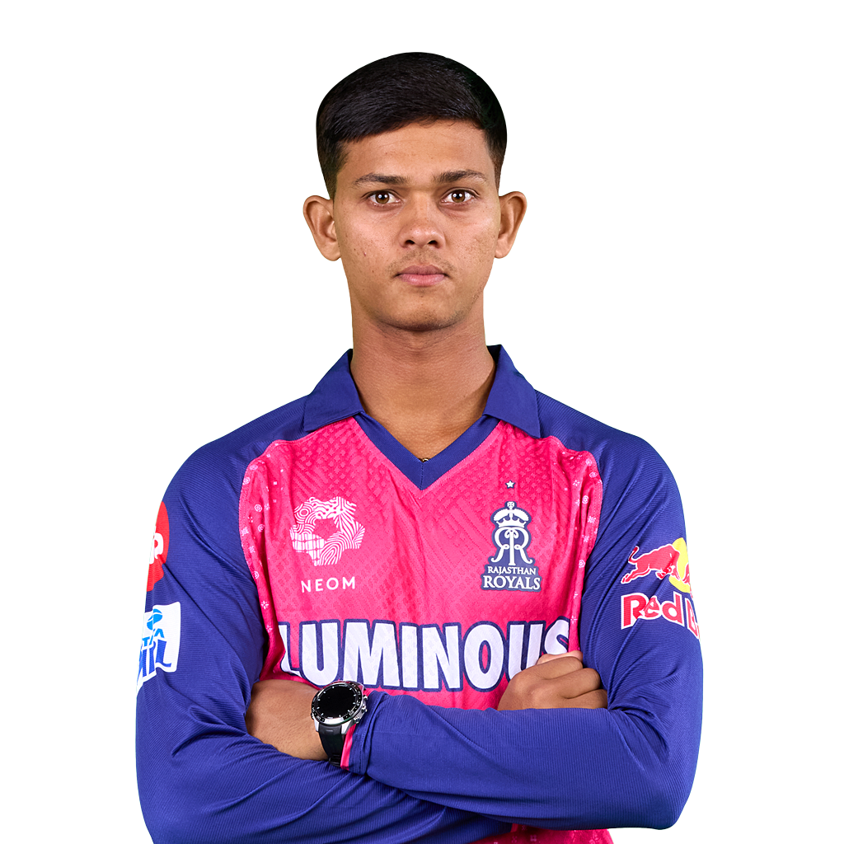
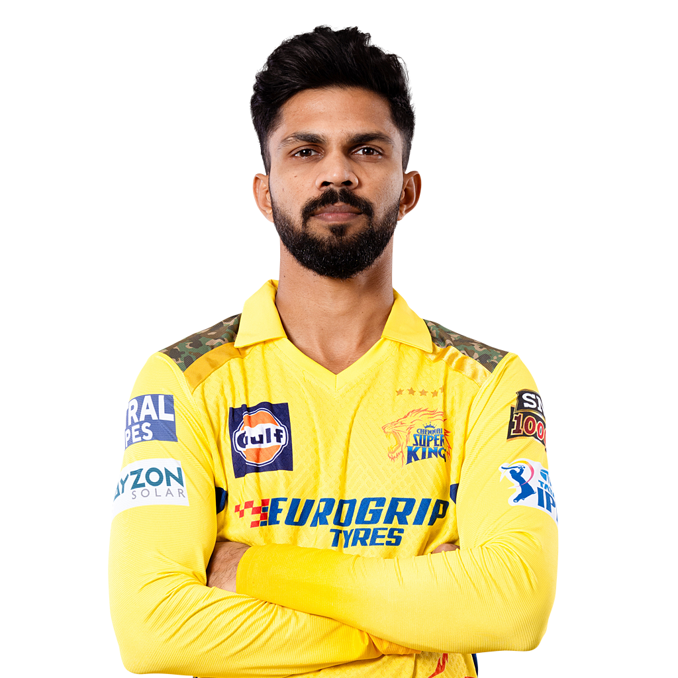
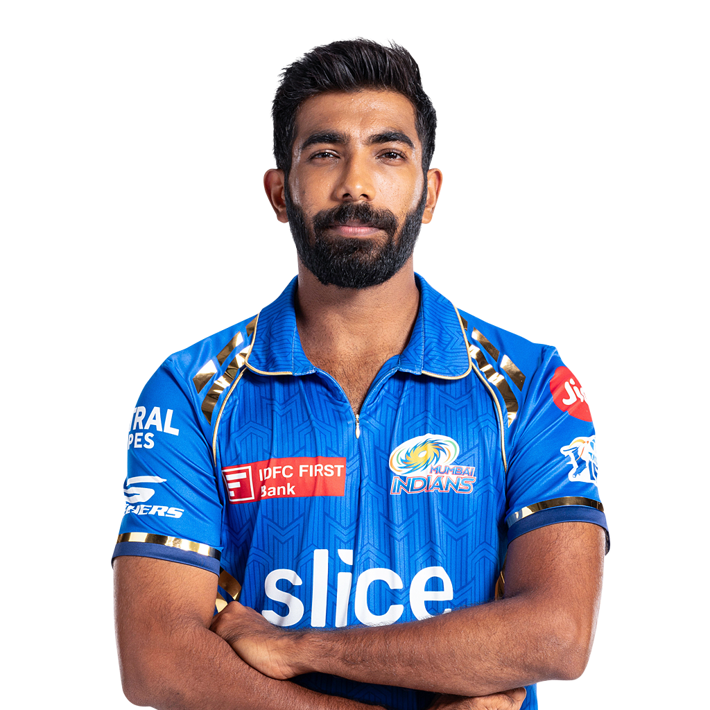
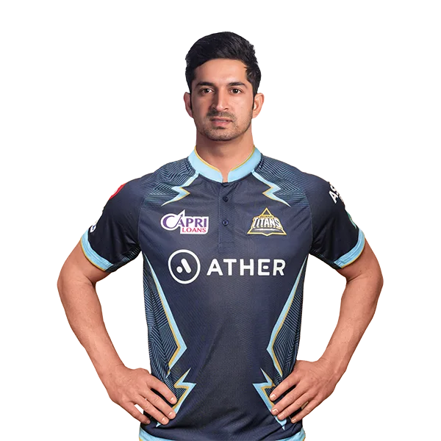
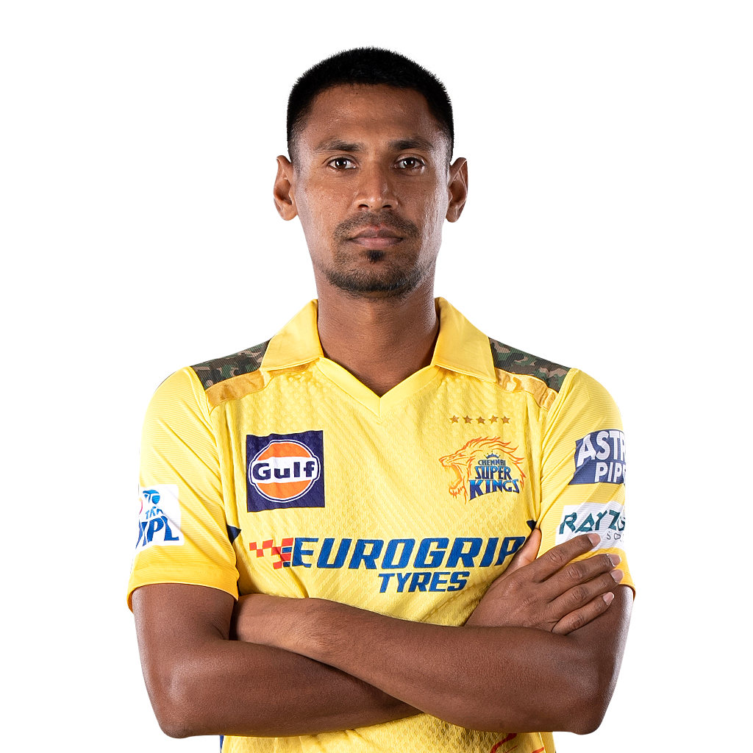
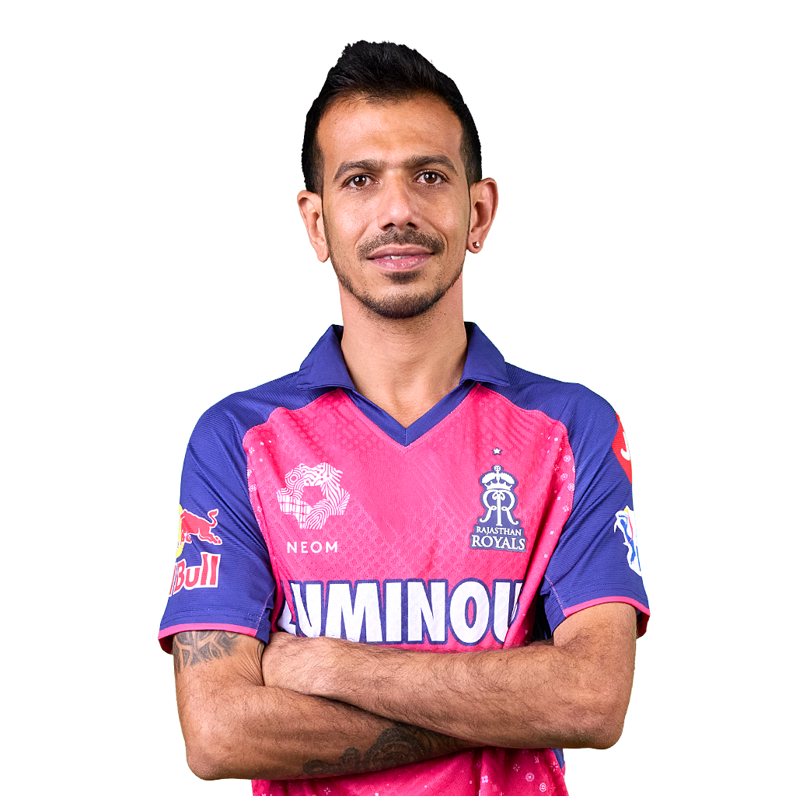
PREDICTION :
ORANGE CAP
VIRAT KOHLI
SHUBMAN GILL
RUTURAJ G.
Y. JAISWAL
PURPLE CAP
J. BUMRAH
MOHIT SHARMA
M.RAHMAN
Y. CHAHAL

Slide 22

PREDICTION :
TOP 4 QUALIFYING TEAMS
WINNER
RUNNER-UP

Slide 23
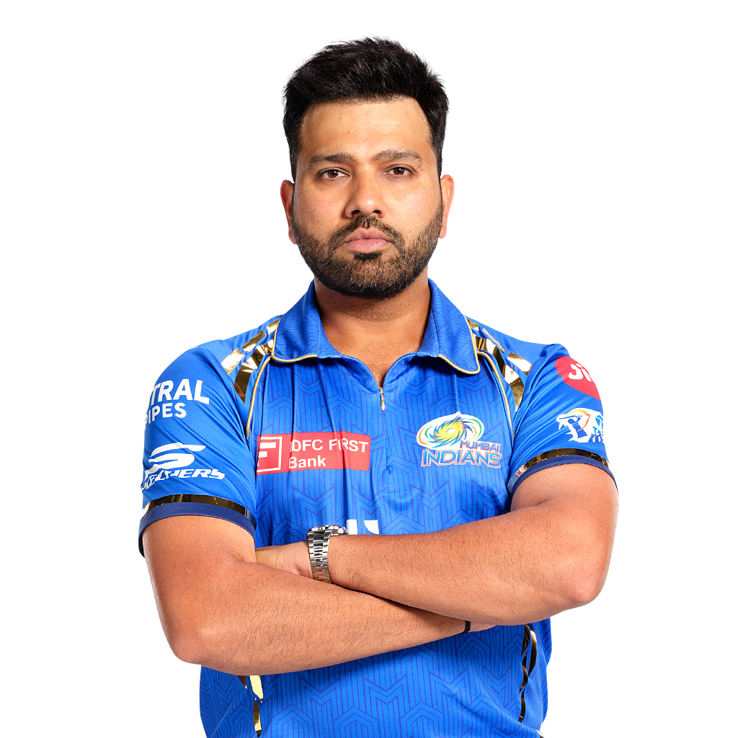
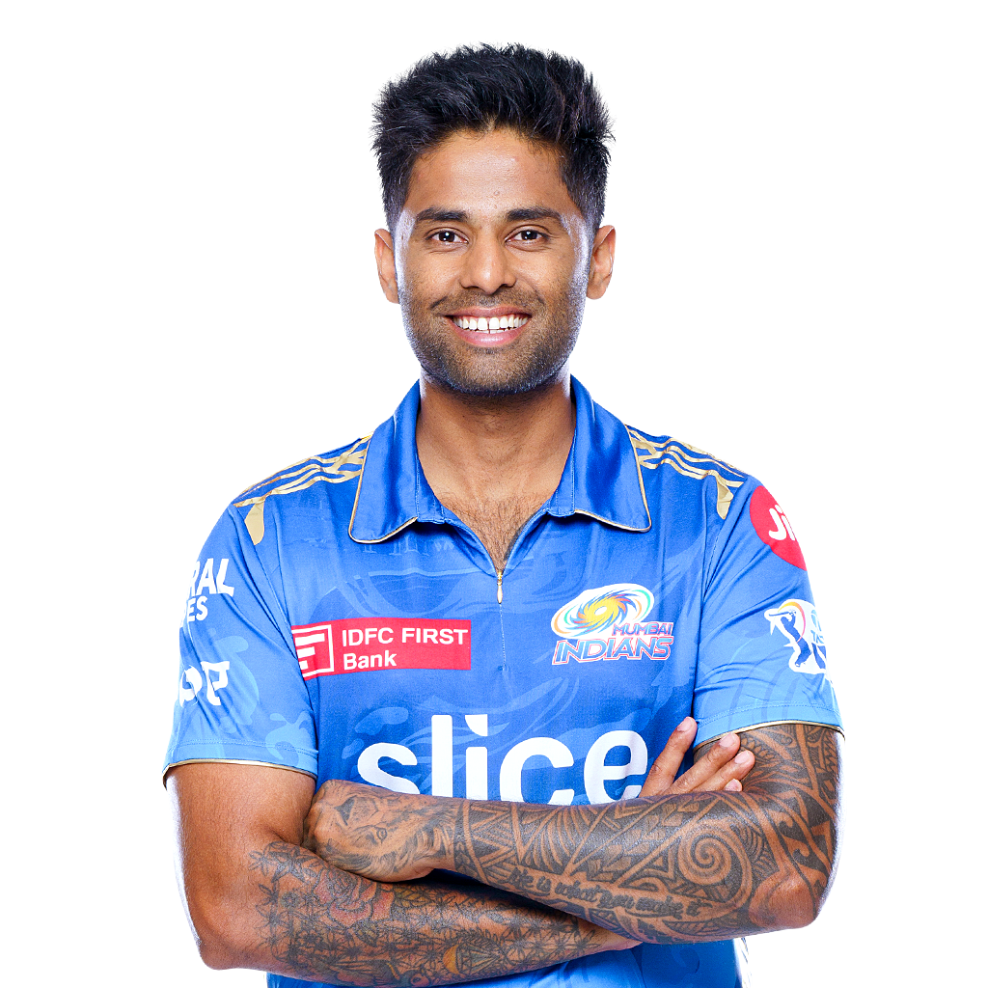

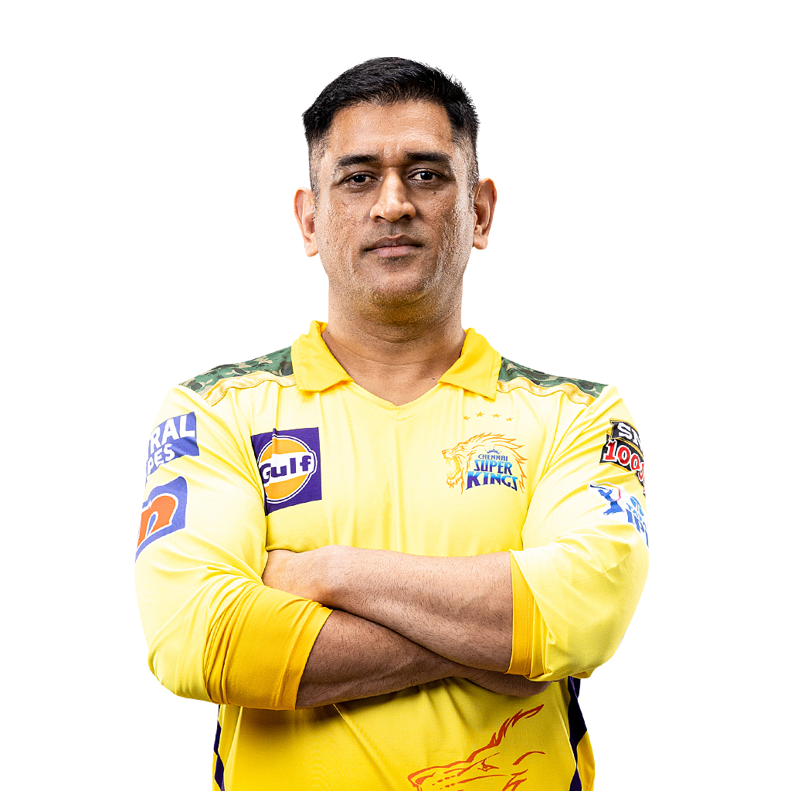
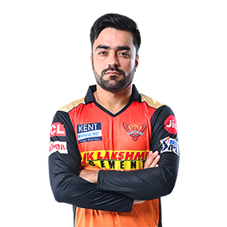
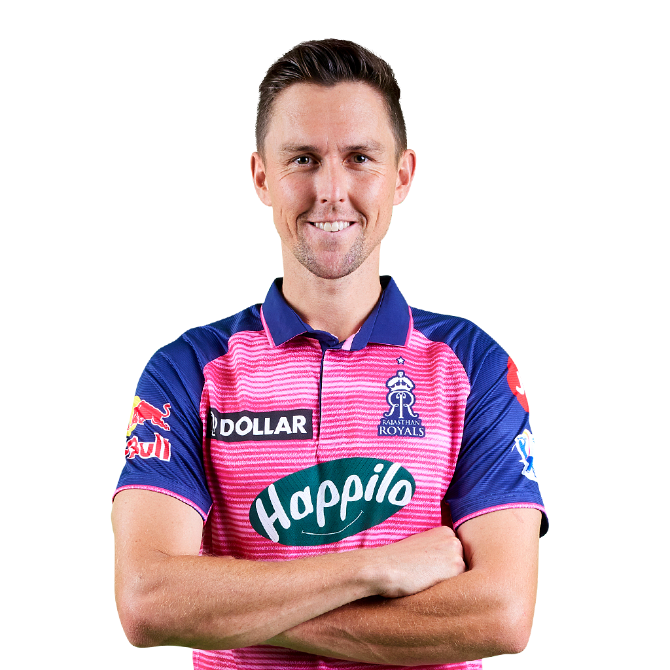
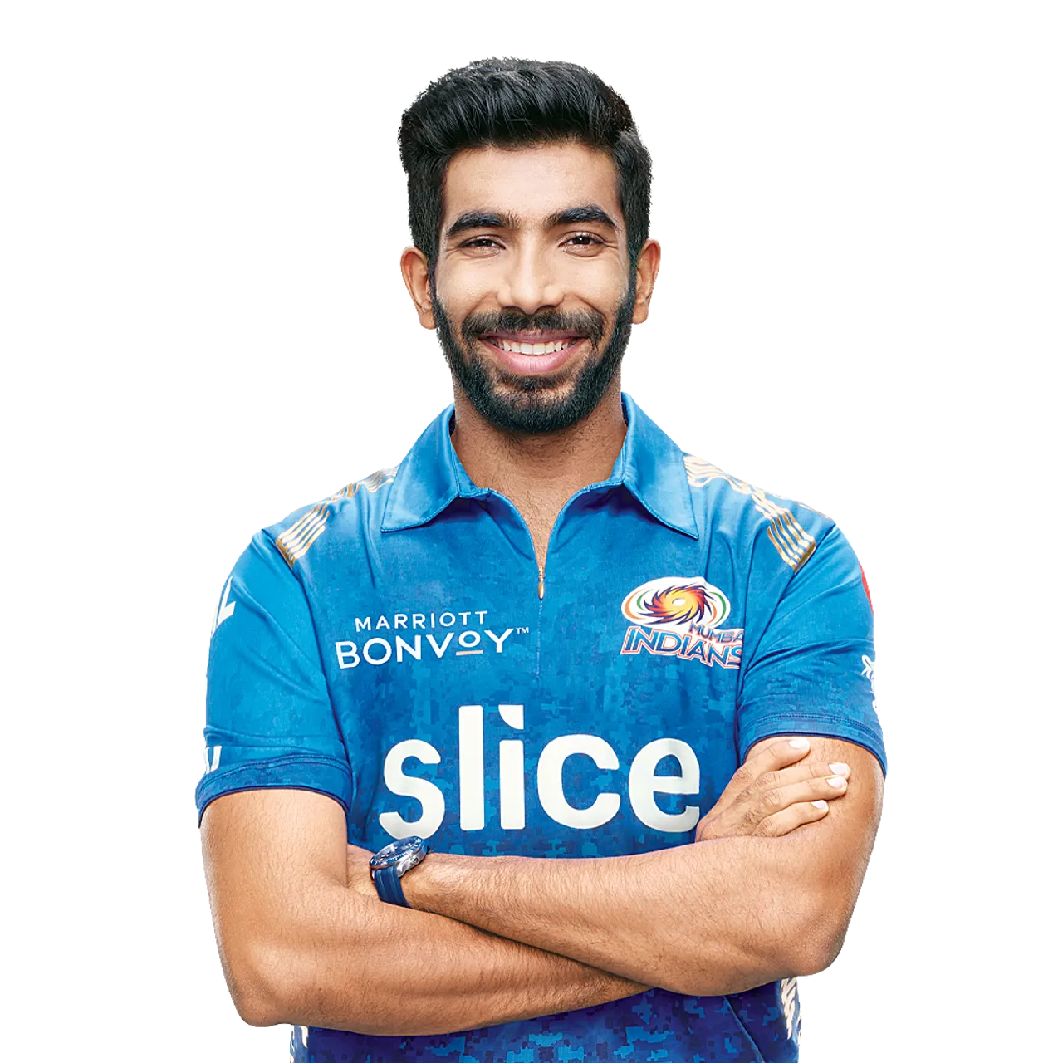
BEST 11 TEAM
CAPTAINMAN
BATSMAN
BATSMAN
BATSMAN
ROHIT SHARMA
VIRAT KOHLI
S. YADAV
FAF DU PLESSIS
Total Innings : 43
Total Runs : 981
SR : 108.34
Total Innings : 45
Total Runs : 1385
SR : 105.67
Total Innings : 38
Total Runs : 1225
SR : 138.76
Total Innings : 46
Total Runs : 1831
SR : 125.11
WICKET-KEEPER
ALL-ROUNDER
ALL-ROUNDER
BOWLER
M.S.DHONI
RASHID KH.
A.RUSSELL
M. SHAMI
Total Innings : 36
Total Runs : 450
SR : 131.08
Total Innings : 46
Total Runs : 304
Total wickets :63
Total Innings : 35
Total Runs : 745
Total wickets :35
Total Innings : 47
Total wickets :67
Economy RT: 7.92
BOWLER
BOWLER
BOWLER
TRENT BOULT
J. BUMRAH
Y. CHAHAL
Total Innings : 40
Total wickets :42
Economy RT: 8.06
Total Innings : 28
Total wickets :36
Economy RT: 7.33
Total Innings : 46
Total wickets :66
Economy RT: 7.74

Slide 24


